Slide 1

SOCIAL MEDIA PROJECT (META)
Prepared by : LAKSHYA HASIJA
Course : Professional Certificate Course In Data Science – May 2025

Slide 2
Content
About Meta
Problem Statement
Database Schema
Table Overview
Data Overview
Approach
Key Metrics
User Classification
User Activity (Photos, Likes, Comments)
Engagement Rate
Recommendation
Conclusion

Slide 3
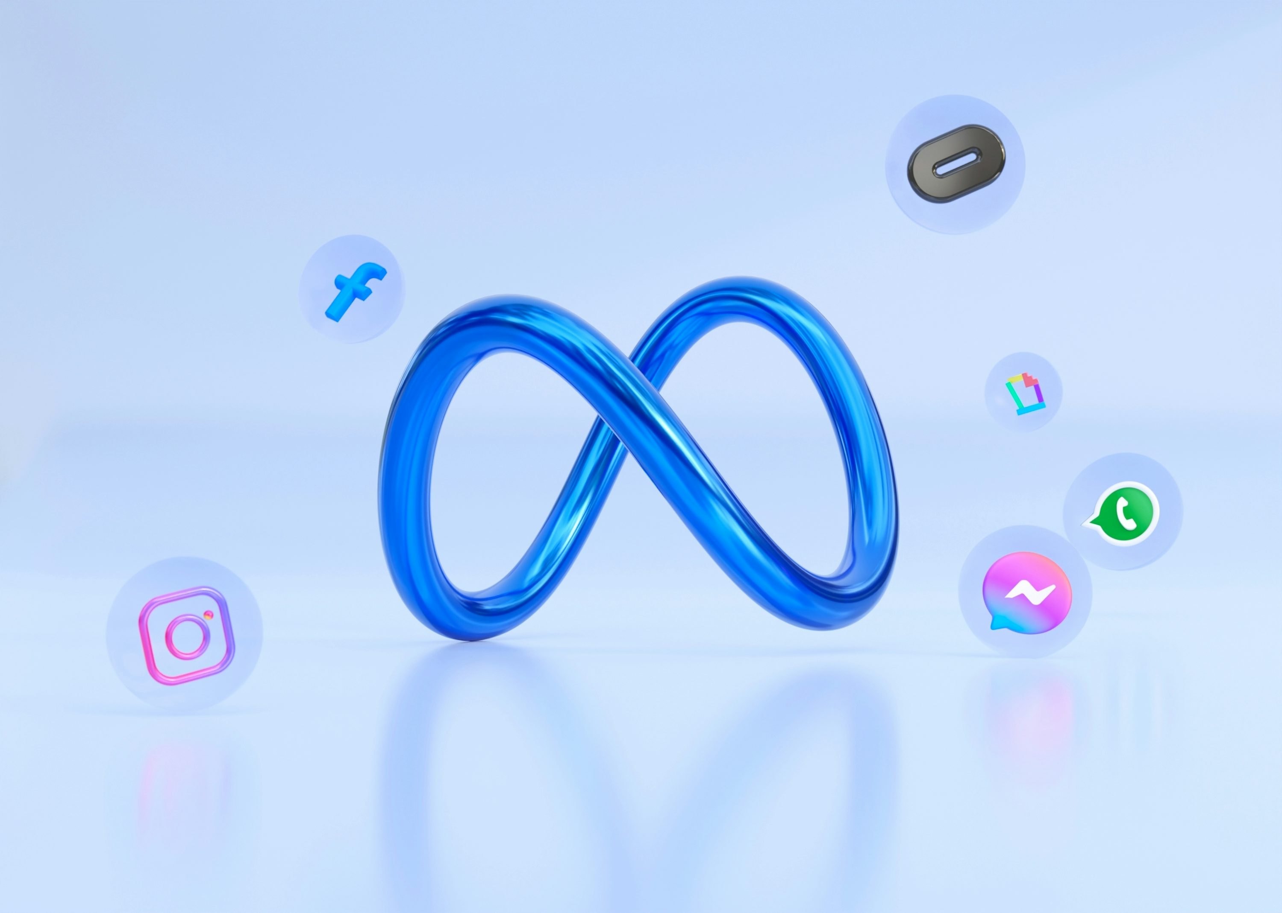
ABOUT META
Meta is a global technology company founded by Mark Zuckerberg, originally known as Facebook, Inc. In 2021, it rebranded to Meta to reflect its broader vision beyond social media. The company owns some of the world’s most popular platforms, including Facebook, Instagram, WhatsApp, and Messenger, which connect billions of people every day.
Meta’s mission is to bring people closer together and build strong digital communities. Along with social networking, the company is heavily investing in future technologies like Virtual Reality (VR) and Augmented Reality (AR).
Its biggest project is the Metaverse, a virtual world where people can socialize, work, learn, and play in immersive ways. Through innovation in AI, connectivity, and digital experiences, Meta is shaping the future of how humans interact online.

Slide 4
Problem statement
You are hired as a data analyst at Meta and asked to collaborate with the Marketing team. Marketing teams want to leverage Instagram's user data to develop targeted marketing strategies that will increase user engagement, retention, and acquisition. Provide insights and recommendations to address the following objectives.

Slide 5
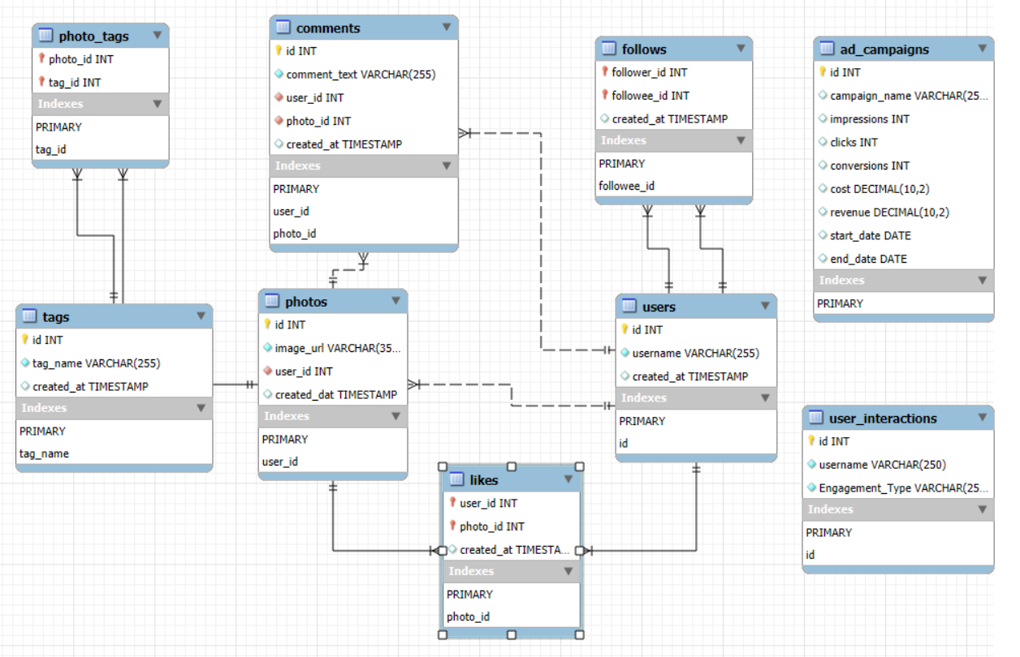
DATABASE SCHEMA

Slide 6
Table Overview
comments_id : unique identifier for each comment
comment_text : text content of a given comment
user_id : unique identifier for each user
photo_id : unique identifier for each photo
created_at : date of interaction in the form like, photos, tags
follower_id : user_id of the follower for a certain user
followee_id : user_id of followee for a certain user
tag_id : unique identifier for each tag
image_url : link to the image posted on the platform
username : username chosen by the user

Slide 7
Data Overview
Total 7 Tables are present in the given dataset.
Tables in dataset – users, comments, likes, photos, photo_tags, tags, follows.
Total number users are 100.
Total number of posts made so far is 257.
Total number of likes posted by the users on posts is 8782.
Total number of comments on all posts are 7488.

Slide 8
Approach
Clarified the main objectives and questions of the analysis while ensuring the data sources aligned with analytical goals.
Cleaned and refined the dataset by removing duplicates and handling missing or inconsistent values for better accuracy.
Utilized SQL techniques such as CTEs, subqueries, GROUP BY, and ranking functions to extract and interpret insights.
Designed charts and graphs to visualize engagement metrics like posts, likes, and comments, highlighting top users and hashtags.
Developed actionable strategies to enhance user engagement and retention based on data-driven insights.
Implemented and refined strategies through optimization methods to achieve consistent improvements in engagement outcomes.

Slide 9




Key Metrics
Likes
Comments
Photos

Slide 10
User Classification
There are 30 Users who come under Highly Engaged category.
34 Users come under Moderately Engaged category.
10 user come in Less Engaged category.
Total of 48 (65%) of the current total users are old users. (Joined before 2017)
Remaining of 26 (35%) users are New means they joined after 2017.
These classification is so that personalized ads and campaigns can be made for different class to improve engagement rates and make interface user friendly.

Slide 11
User Activity On Photos
The chart displays the total number of posts made by users on the platform.
Out of 100 users, 26 have not posted any photos, while 18 users have posted only once.
Very few users (1 or 2) have shared more than 6 posts, with only one user reaching 12 posts.
This indicates that most users are minimally active, highlighting the need to boost participation and content sharing.

Slide 12
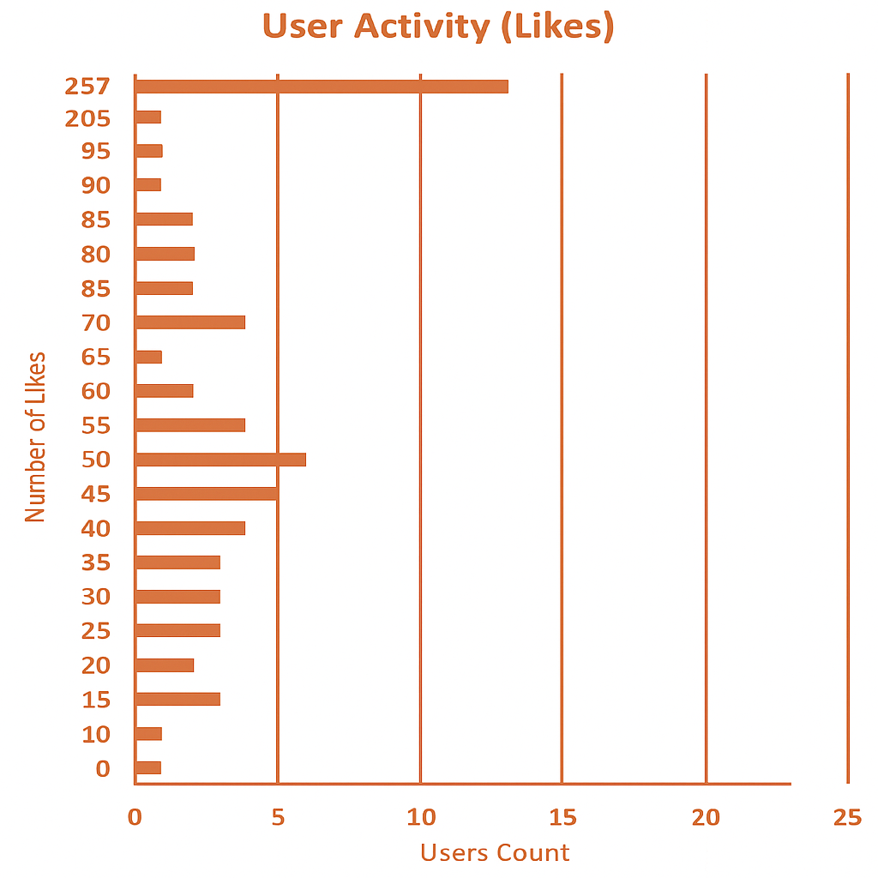
User Activity On Likes
The chart highlights how users engage with posts through likes across the platform.
About 22 users have not given any likes, reflecting low overall engagement.
A few users are highly active, with one exceptional user giving 257 likes.
Most users show moderate activity, giving likes in the 75–95 range.

Slide 13
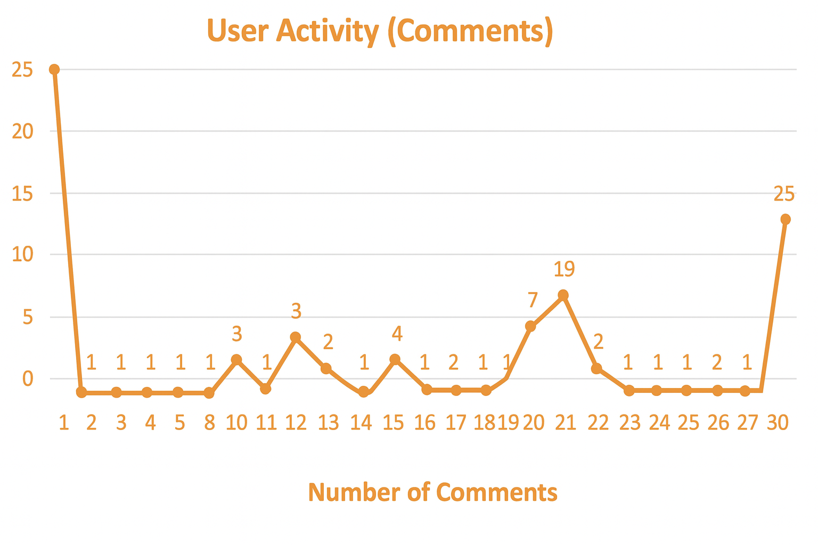
User Activity On Comments
The chart displays how users are interacting with content by commenting.
A significant number of users (23) have not made any comments, indicating limited interaction.
Only a few users are highly active — one user made 257 comments, which is a major outlier.
Most users comment very little, typically only once or twice.

Slide 14
Hashtags vs Engagement
All hashtags show consistent engagement levels between 63 and 65, indicating balanced user interest across topics.
Hashtags like beauty, delicious, and foodie have the highest engagement of 65, showing strong user appeal.
Hashtags such as dreamy, food, photography, smile, stunning, and sunset maintain solid engagement at 64.
The beach hashtag has slightly lower engagement at 63 but remains aligned with other popular themes.

Slide 15
User Retention
Suggested targeted posts, hashtags, and users to re–engage inactive users through Stories and Reels.
Offered time-limited discounts and loyalty rewards to motivate consistent engagement.
Shared tutorials and highlighted new trends to simplify content creation and attract users.
Conducted surveys and organized community programs to gather feedback and build loyalty.

Slide 16
User Acquisition
Designed a personalized onboarding process showcasing features, tags, and success stories through blogs and tutorials.
Introduced referral programs and loyalty rewards like discounts, badges, and premium perks to attract and retain users.
Recommended targeted posts, hashtags, and users while using Stories, Reels, and emails to boost engagement.
Collected user feedback through surveys and organized events with influencers to strengthen community loyalty.

Slide 17
User ENGAGEMENT
Introduced awards and contests to recognize active contributors and boost motivation.
Shared tutorials and webinars to educate users and enhance engagement.
Built community connections through forums, events, and ambassador programs.
Collaborated with influencers to attract new users and strengthen participation.

Slide 18
Tag Categorization
For Better understanding, I have categorized tags into 8 different Categories:
CATEGORY | TAGS
Joy-Emotions | Happy , Smile
Aesthetics | Stunning , Dreamy
Food | Delicious , Food , Foodie
Party & Fun | Concert , Party , Drunk , Lol , Fun
Beauty | Beauty , Hair
Landscape | Landscape , Sunrise , Sunset , Beach
Fashion | Fashion , Style
Photography | Photography

Slide 19
CONTENT–CENTRIC ANALYSIS
Most Liked Categories – Party & Fun, Landscape, Joy-Emotions represents users that are drawn to energetic, visually appealing, and emotionally uplifting content.
While Least Liked Categories – Photography, Aesthetics have low overall engagement, they may still resonate with a niche audience.

Slide 20

Campaigns and Projections
Target audience on the basis of categories and content they brows.
Personalized notification and emails should be sent to the users to increase engagement.
Notification should be catchy and funny so user may not feel disturbed and irritated.
Analyze the ad campaigns which are getting low response and substitute them.
Collaborations should be done with brands and users, pay the user for paid posts who have better reach and engagement.

Slide 21
OVERALL Engagement
Measured engagement using likes, comments, and posts, ranked users with DENSE_RANK, and offered tiered rewards for loyalty.
Reconnected inactive users through personalized nudges, challenges, and community-driven engagement.
Utilized trending hashtags and influencer collaborations to enhance content visibility and campaign reach.
Analyzed engagement peaks by time and optimized posting schedules for higher visibility.
Segmented users by activity levels and tenure to enable targeted and personalized engagement campaigns.

Slide 22

CONCLUSION
The Social Media (META) Project highlights how SQL-driven analysis provides actionable insights into user behavior, engagement, and content performance. Users were segmented into Active, Moderately Active, and Inactive groups, with special attention on re – engaging inactive users.
Key findings emphasize the role of hashtags, reels, and influencer collaborations in driving engagement, while personalized recommendations, optimized ads, and targeted notifications strengthen retention.
From a business perspective, the analysis supports targeted marketing, user retention, and monetization strategies, aligning data insights with organizational goals. Overall, the project demonstrates how data science transforms raw data into strategies that enhance growth, engagement, and long-term success.

Slide 23

THANK YOU

